Slide 1
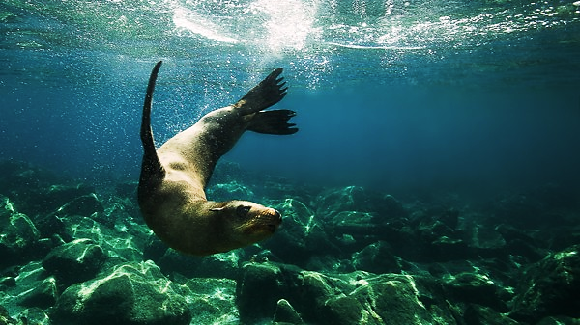
Analyzing Sea Lion Aquatic Turning Performance Using AI Generated R Code
BIO 5100
Ariel Leahy

Slide 2
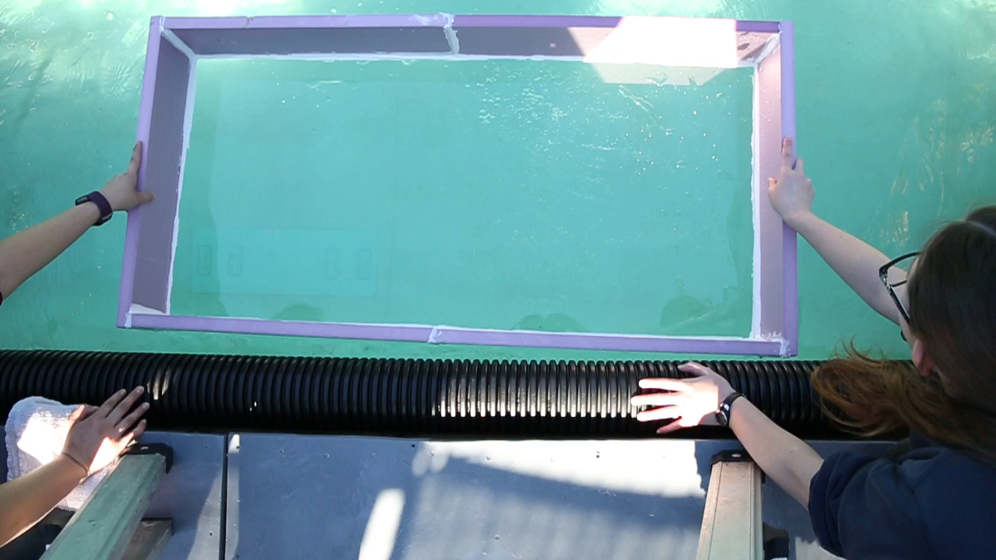

Slide 3
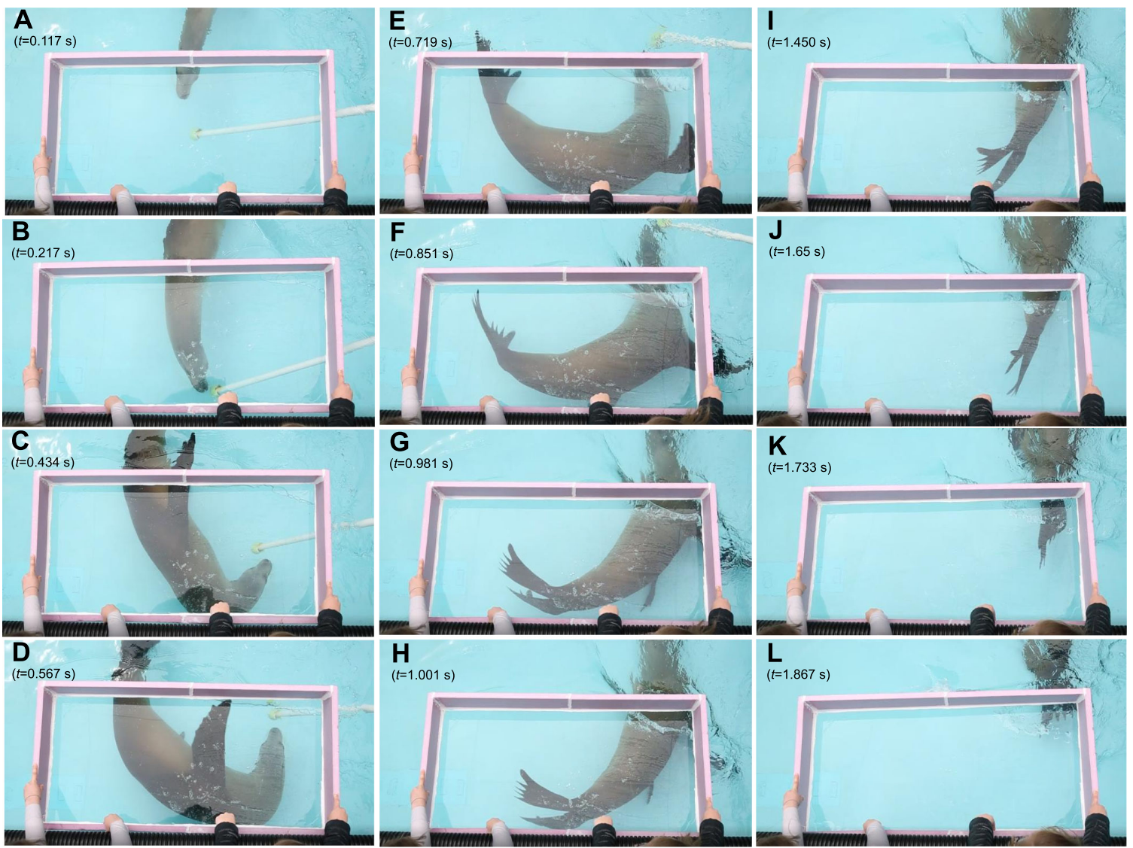
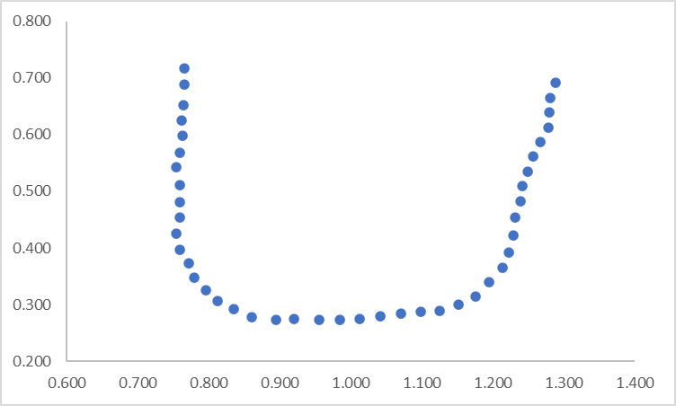
x_space_m | y_space_m | timestamp_sec
0.625 | 0.703 | 0.016667
0.623 | 0.655 | 0.033334
0.630 | 0.613 | 0.050001
0.638 | 0.578 | 0.066668
0.643 | 0.533 | 1.016667
0.668 | 0.486 | 1.033334
0.693 | 0.453 | 1.050001
0.725 | 0.423 | 1.066668
0.752 | 0.396 | 2.016667
0.792 | 0.366 | 2.033334
0.842 | 0.344 | 2.050001
0.875 | 0.326 | 2.066668
0.922 | 0.316 | 3.016667
0.967 | 0.316 | 3.033334
1.002 | 0.321 | 3.050001
Pool Length (m)
Pool Width (m)

Slide 4
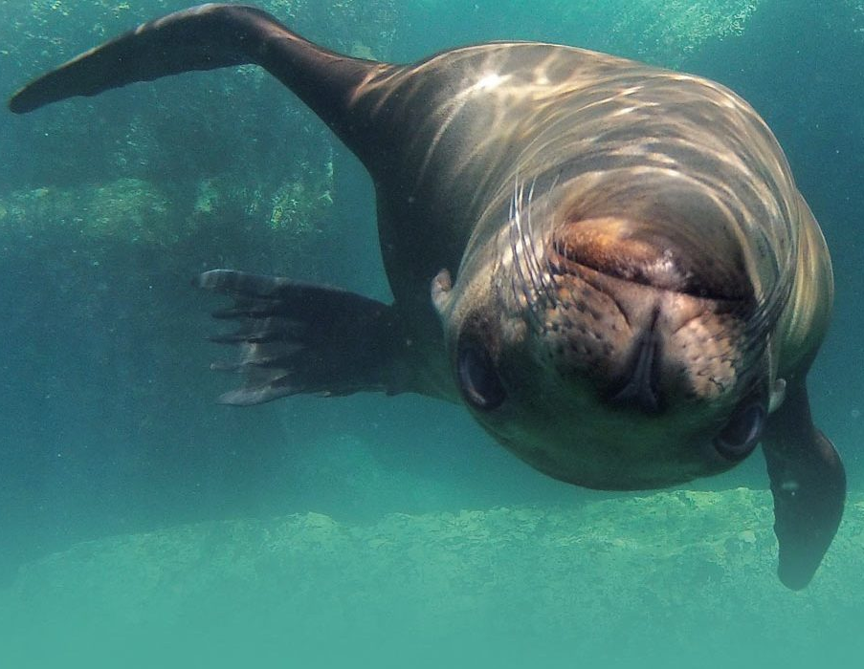
OBJECTIVES
Recreate and improve Matlab code used in Leahy et al. (2021) that analyzed sea lion turning performance using 10 attempts in each ChatGPT and Bing Copilot and MINIMAL user editing
Compare the occurrence of errors and error handling by ChatGPT and Bing Copilot
- “That code didn’t work, I got the following error [insert quoted error from R], please revise the R code to fix this issue”.

Slide 5
PROMPT
“I have biomechanical data of sea lions performing aquatic turns. This data includes animal body length (in meters) “length_m”, x,y coordinates of anatomical points of the sea lion throughout the aquatic turn (in meters) “x_space_m” and “y_space_m”, and the timestamps (in seconds) “timestamp_sec” associated with the anatomical x,y coordinates throughout the video. [pasted in example set of data]
Can you please write a functional r code, including all package downloads and library, that will use the animal’s body length, timestamps, and extracted x,y coordinates of manually tracked 2D video to calculate the animal’s turning rate ( in degrees per second), turning radius (in meters), convert turning rate into radians to then calculate turning velocity ( in meters per second), centripetal acceleration of the turn (in meters per second squared), and g-force of the turn (in multiples of gravitational force), in that specific order.”

Slide 6
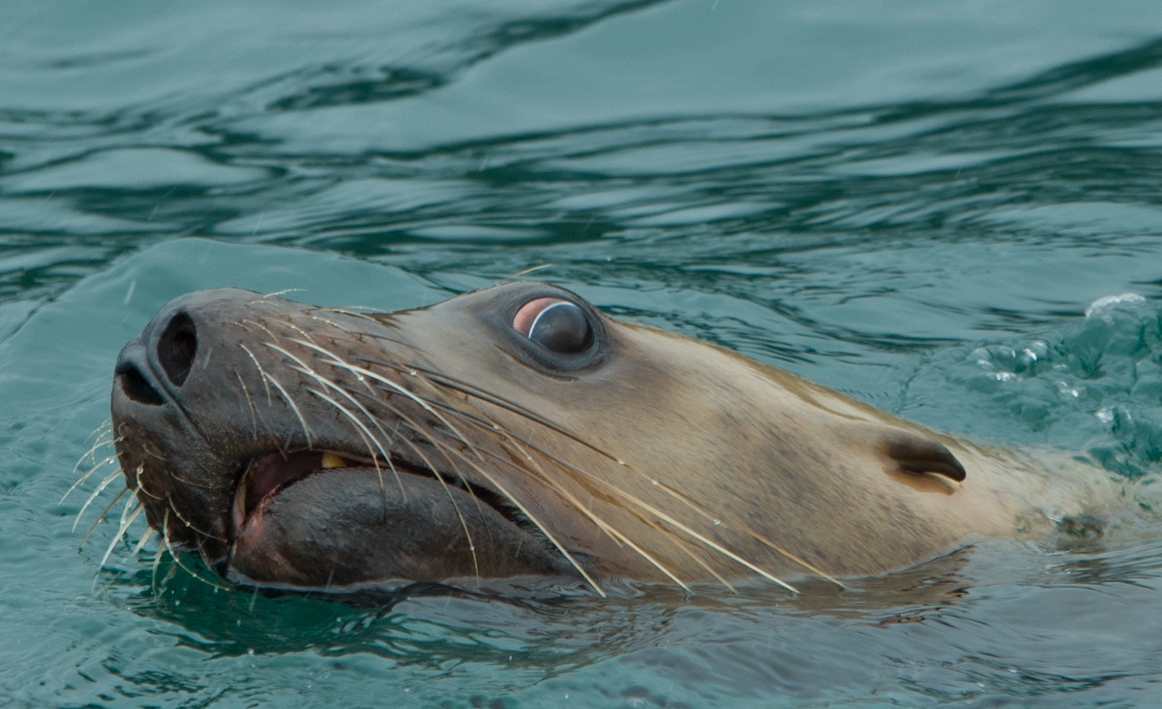
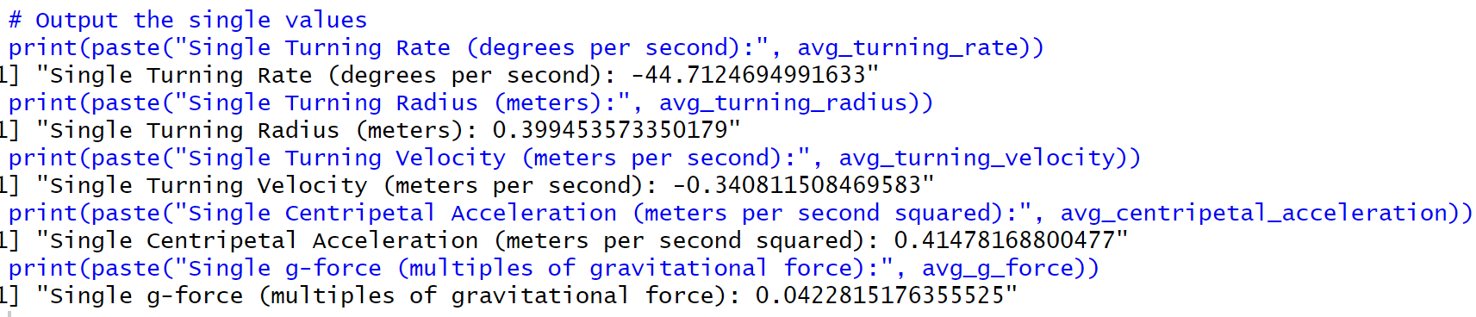
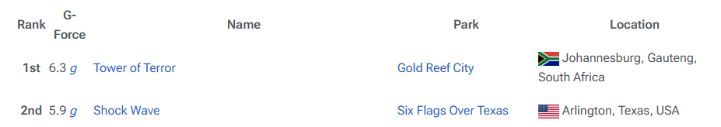
CHATGPT
5.1g
Video # | Sea Lion | Rate (deg/s) | Radius (m/s) | Velocity (m/s) | Centripedal Acceleration (m/s^2) | g
377A2948 | Ariel | 438.251 | 0.3455 | 2.6 | 20.2 | 2.1

Slide 7
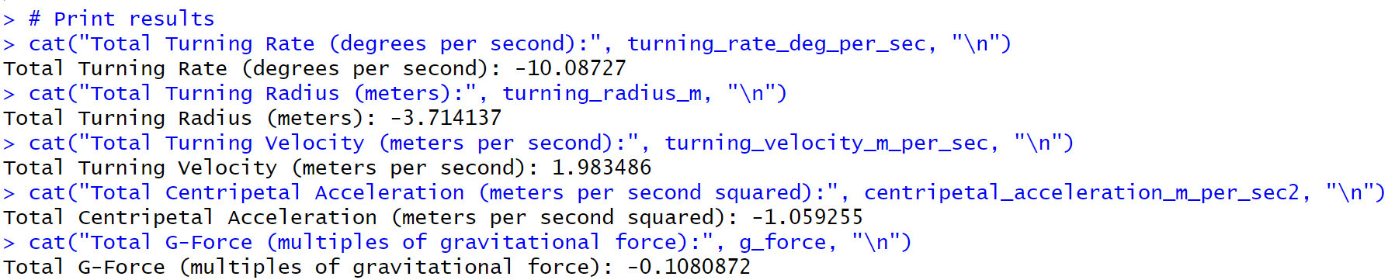
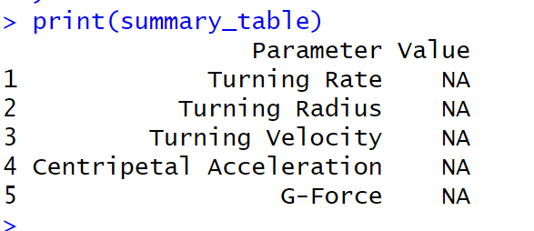
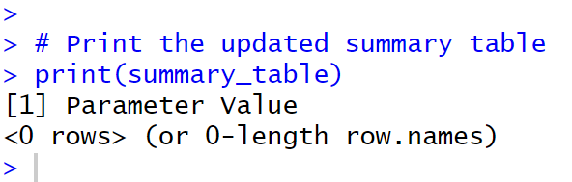
COPILOT
Video # | Sea Lion | Rate (deg/s) | Radius (m/s) | Velocity (m/s) | Centripedal Acceleration (m/s^2) | g
377A2948 | Ariel | 438.251 | 0.3455 | 2.6 | 20.2 | 2.1

Slide 8
EDITED PROMPT
“I have biomechanical data of sea lions performing aquatic turns. This data includes animal body length (in meters) “length_m”, x,y coordinates of anatomical points of the sea lion throughout the aquatic turn (in meters) “x_space_m” and “y_space_m”, and the timestamps (in seconds) “timestamp_sec” associated with the anatomical x,y coordinates throughout the video. [pasted in example set of data]
Can you please write a functional r code that includes all package downloads and library, and utilizes tidyverse and read.csv to access the data file through “ read.csv(“**specific computer path**")” Ideally, this r code will use the timestamps, and extracted x,y coordinates of manually tracked 2D video to calculate turning parameters such as the animal’s turning rate ( in degrees per second), turning radius (in meters), convert turning rate into radians to then calculate turning velocity ( in meters per second), centripetal acceleration of the turn (in meters per second squared), and g-force of the turn (in multiples of gravitational force), in that specific order. The ideal output will be a table with a single value calculated across the entirety of the turn for each of the turning parameters (turning rate, turning radius, turning velocity, centripetal acceleration, and g-force).”

Slide 9
CHATGPT VS COPILOT
 | Attempts | Errors | Functional | Functioning Correctly
ChatGPT | 10 | 0 | Yes | No
Copilot | 10 | 4 | Yes/No | No
My goal was to recreate a Matlab code used in Leahy et al., 2021 with MINIMAL code editing from myself
Under these restrictions, I have not been able to recreate the code
I am still attempting to break the requests down piece by piece and seeing if I can recreate the code with more input and editing on my end

Slide 10
REFERENCES
Cheneval, O., Blake, R.W., Trites, A.W., and Chan, K.H.S. (2007). Turning maneuvers in steller sea lions (Eumatopias jubatus). Marine Mammal Science, 23:94-109, DOI: 10.1111/j.1748-7692.2006.00094.x
Fish, F.E., Hurley, J., and Costa, D.P. (2003). Maneuverability by the sea lion Zalophus californianus: turning performance of an unstable body design. Journal of Experimental Biology, 206, 667-674, https://doi.org/10.1242/jeb.00144
Leahy, A.M., Fish, F.E., Kerr, S.J., Zeligs, J.A., Skrovan, S., Cardenas, K.L., and Leftwich, M.C. (2021). The role of California sea lion (Zalophus californianus) hindflippers as aquatic control surfaces for maneuverability. Journal of Experimental Biology, 224 (20): jeb243020
Liu, Y., Le-Cong, T., Widyasari, R., Tantithamthavorn, C., Li, L., Xuan-Bach D. Le, X.B.D., and Lo, D. (2024). Refining ChatGPT-Generated Code: Characterizing and Mitigating Code Quality Issues. ACM Transactions on Software Engineering and Methodology, https://doi.org/10.1145/3643674
Merow, C., Serra-Diaz, J.M., Enquist, B.J., and Wilson A.M. (2023). AI chatbots can boost scientific coding. Nature Ecology & Evolution, 7, 960–962. https://doi.org/10.1038/s41559-023-02063-3
Perkel, J.M. (2023). Six tips for better coding with ChatGPT. Nature, 618, 422–423. https://doi.org/10.1038/d41586-023-01833-0
R Core Team. (2024). R: A Language and Environment for Statistical Computing. from https://www.r-project.org

Slide 11
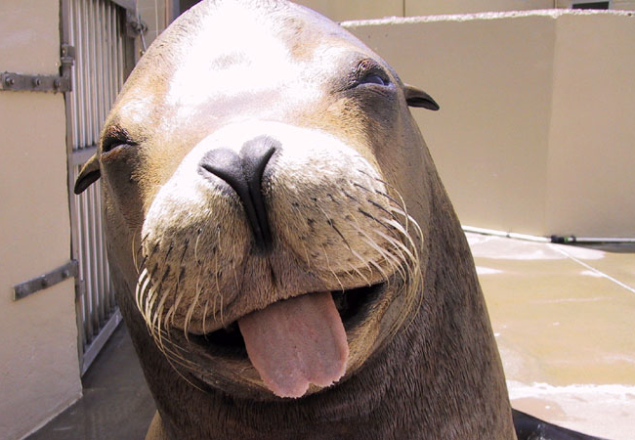
Q
U
E
S
T
I
O
N
S
?

